Slide 1

Project Devil May Drive
Car rental

Slide 2
Our team :
Martin Atanasov Zhelev – Scrum Trainer
Alexander Vladimirov Dyanov – Front-end developer
Georgi Ivaylov Nikolov – Back-end developer
Dimitar Plamenov Nyagalov - Designer

Slide 3
About the project :
The main idea behind this project was to create a simple and user-friendly platform where people can rent cars online. We wanted to make it easy for users to search for available cars, compare prices, and book the vehicle that suits their needs.
Our website includes several features:
A homepage with a search bar where users can choose a location, date, and type of car.
A list of available cars with photos, descriptions, prices per day, and filters like car type or brand.
A booking page where users can fill out their information and confirm the rental.
An admin panel where the site owner can add or remove cars and manage reservations.

Slide 4
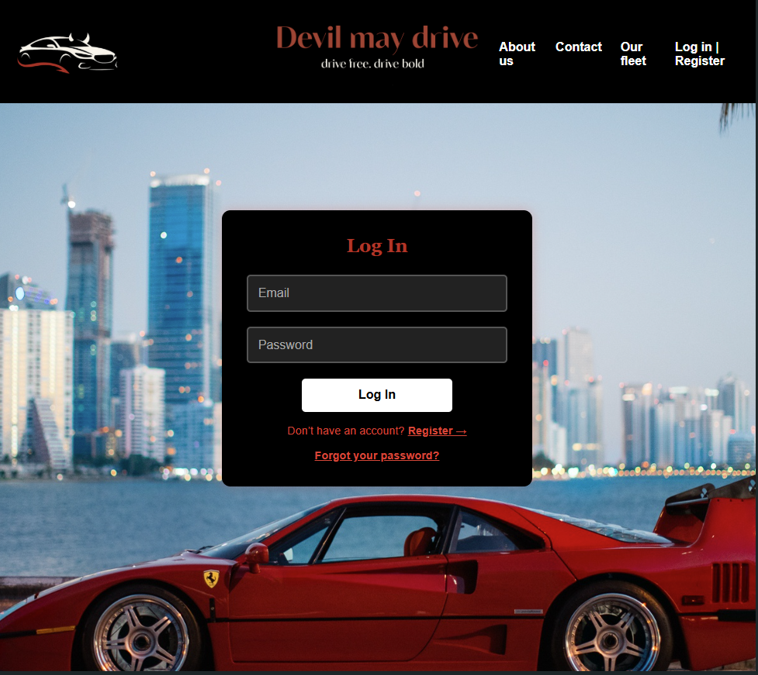
Our goal :
Our goal with Devil May Drive is to build an immersive and dynamic car rental platform that goes beyond utility and becomes an experience. We aim to blend sleek design, smooth navigation, and high-performance vehicle options to create a site that feels like a digital garage for car enthusiasts. By drawing inspiration from luxury, muscle and sport cars, we want to capture the thrill and personality of each ride. The result is a visually compelling, user-friendly, responsive site that makes choosing and renting a car as exciting as driving one.

Slide 5
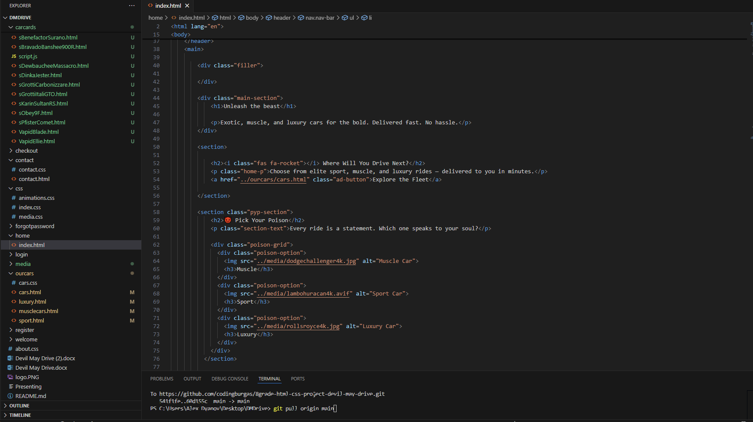
Technologies :
1.Microsoft Teams was used for communication between the teammates.
2.Visual Code Studio was the main app we used in the project.
3.A little Java Script.
4.HTML – 74.8%
5.CSS - 25.2%

Slide 6
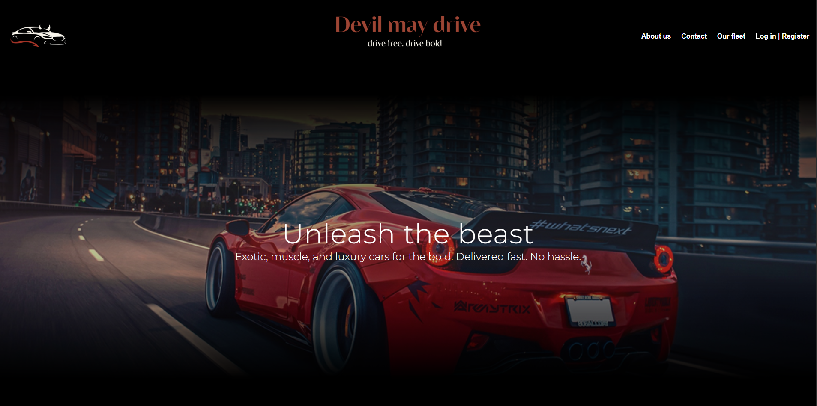
home page

Slide 7
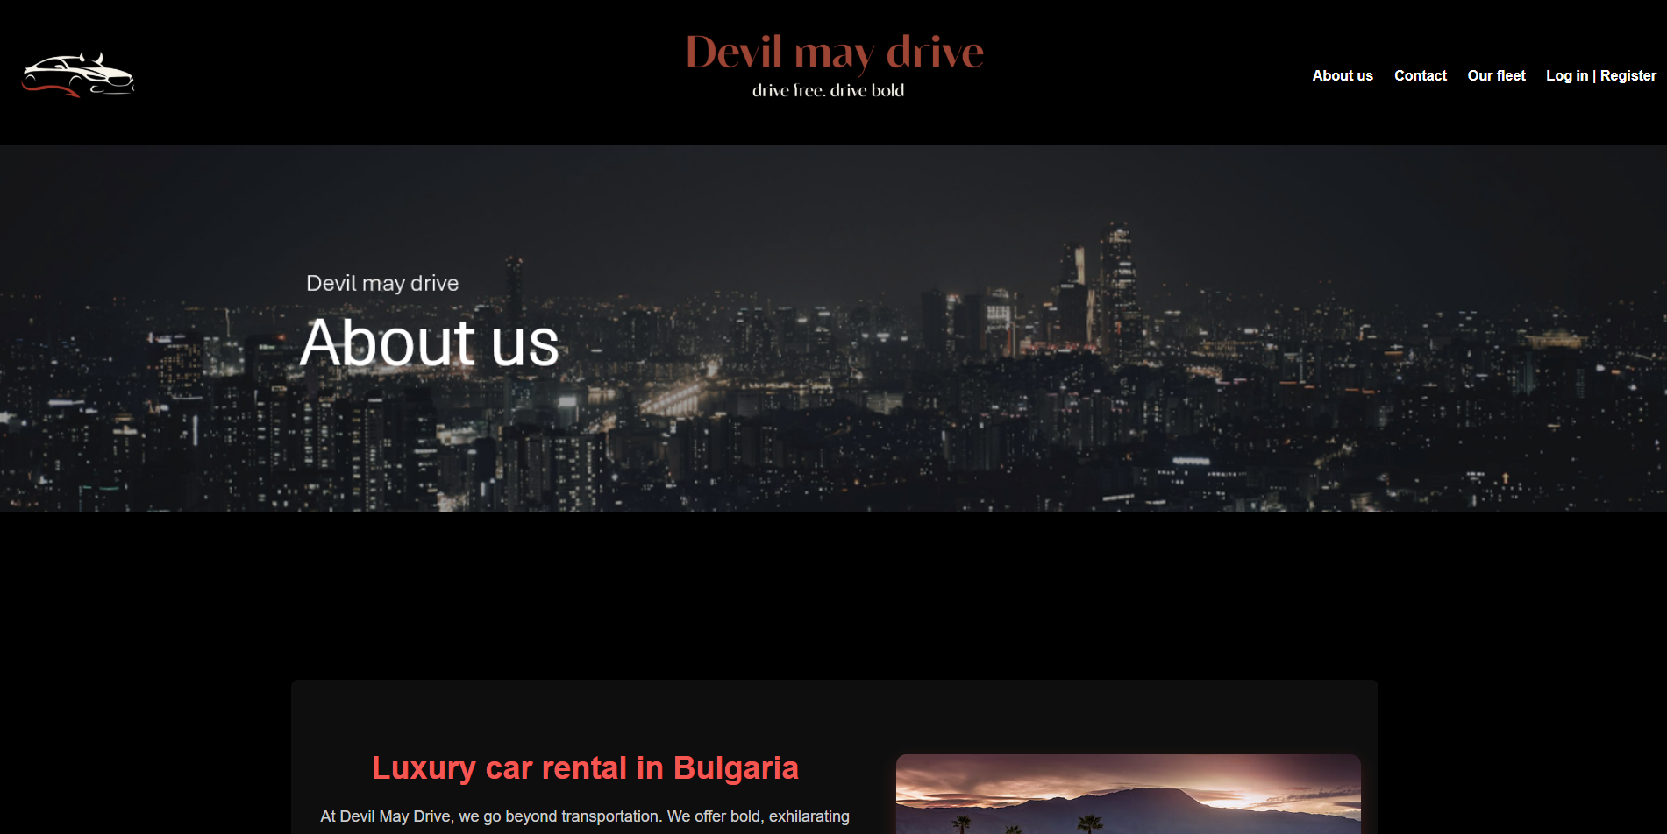
About us

Slide 8
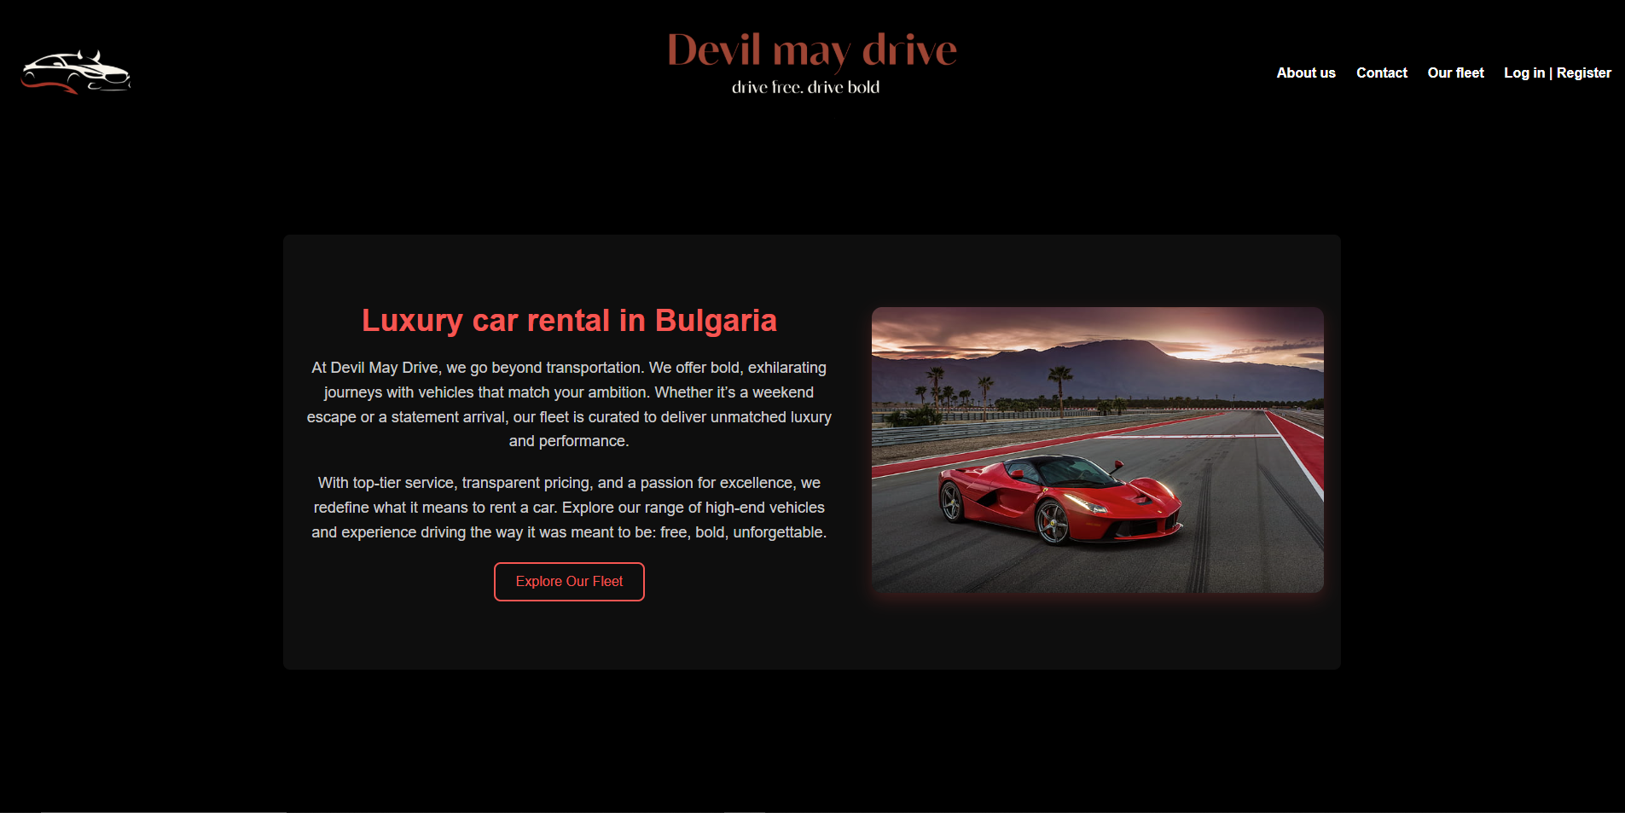
About us

Slide 9
Thanks for the attention

